Slide 1


KITE AI
Jun 2025
The Base Layer for the Agentic Internet
Redefining the AI Trust with Identity, Payment, Governance, and Verification.
Notes:
We have entered an era where AI agents don’t just generate text - they reason, act, and make decisions, coordinate service and transact value
But Infra has to support this

Slide 2


Evolution
The internet's next evolution: agent-first
🌐
Web-First (early 2000s)
Humans on desktops
Static websites, hyperlinks
Content discovery and display, HTML, UI
📱
Mobile-First (early 2010s)
Humans on smartphones
Responsive web & mobile apps
optimized UX, conversions
🤖
Agent-First (2025 - )
AI agents as users
MCPs, APIs, multimodal data
Trust, governance, autonomy
Notes:
Identity, attribution, governance, payment
Kite AI Layer 1 Chain: An EVM-compatible foundation purpose-built for AI applications, providing high throughput and scalability.
• Proof of AI: A novel consensus mechanism ensuring transparent attribution, fair rewards, and coordination across specialized subnets.
• Programmable AI Value Chain: A modular approach to configure collaboration between data, models, and agents.
• Kite AI Developer Tools: Comprehensive toolkits that simplify agent development and reward distribution.
• Kite AI Data Subnets: High-quality data pools designed for advanced AI research and development.
• Kite AI Model Subnets: Robust repositories for building and optimizing AI models.
• Kite AI Agent Subnets: Ecosystems for creating and running intelligent, autonomous agents.
• Application Ecosystem: A rich marketplace where third-party developers launch and scale AI-powered applications.
Identity play, value exchange play

Slide 3
Evolution
Why NOW - The Shift to Agent-First Internet
🔹 Agent is finally usable
Models are smarter – maturity of RL enables reasoning in dynamic env, performance doubled every 7 mons.
Models are cheaper – cost to run inference has dropped significantly, price down 80% per year
Open-source models now meet business-grade requirements
🔹 Agent development is easier than ever
Frameworks like MCP and A2A are maturing
Agent stacks can be bootstrapped in hours, not weeks
🔹 Trillions of agents are coming
Personalized & verticalized agents are now feasible
Unicorn startups run by one founder plus an army of agents
Anyone can build customized agents with minimal effort
Explosive growth from developer and user ecosystems
Notes:
Identity, attribution, governance, payment
Kite AI Layer 1 Chain: An EVM-compatible foundation purpose-built for AI applications, providing high throughput and scalability.
• Proof of AI: A novel consensus mechanism ensuring transparent attribution, fair rewards, and coordination across specialized subnets.
• Programmable AI Value Chain: A modular approach to configure collaboration between data, models, and agents.
• Kite AI Developer Tools: Comprehensive toolkits that simplify agent development and reward distribution.
• Kite AI Data Subnets: High-quality data pools designed for advanced AI research and development.
• Kite AI Model Subnets: Robust repositories for building and optimizing AI models.
• Kite AI Agent Subnets: Ecosystems for creating and running intelligent, autonomous agents.
• Application Ecosystem: A rich marketplace where third-party developers launch and scale AI-powered applications.
Identity play, value exchange play

Slide 4

Challenges
Human Centric vs Agentic Internet
Human centric internet
Agentic internet
❌No identity for “Agent”
✅ Identity for Agent and Owner
Customer
A
I
✅ Global instant payments with crypto wallet
❌Slow, localized
Credit card, ACH, …
Payment Rails
❌blocked by human authorization
✅ Pre-authorization and control
Manual authorization on Websites
Smart contract
Authorization

Slide 5
Challenges
Key challenges of the Agentic Internet
What we desire: Agents can operate autonomously with trust
❌
Identity & Attestation
How do agents prove they are legitimate?
Shift from proving humanity to verifying delegated authority
Requires verifiable ID (e.g., wallet-linked credentials)
❌
Governance & Permissions
Need fine-grained control over agent behaviors
Delegation rights, scope, and spend limits must be programmable
Smart contract-based 'agent passports'
❌
Autonomous & Verifiable Transaction
Requires new payment rails—instant, low-cost, auditable
Every interaction must leave a cryptographic trail
Ensure transparency, provenance, and trust at scale
Notes:
Identity, attribution, governance, payment
Kite AI Layer 1 Chain: An EVM-compatible foundation purpose-built for AI applications, providing high throughput and scalability.
• Proof of AI: A novel consensus mechanism ensuring transparent attribution, fair rewards, and coordination across specialized subnets.
• Programmable AI Value Chain: A modular approach to configure collaboration between data, models, and agents.
• Kite AI Developer Tools: Comprehensive toolkits that simplify agent development and reward distribution.
• Kite AI Data Subnets: High-quality data pools designed for advanced AI research and development.
• Kite AI Model Subnets: Robust repositories for building and optimizing AI models.
• Kite AI Agent Subnets: Ecosystems for creating and running intelligent, autonomous agents.
• Application Ecosystem: A rich marketplace where third-party developers launch and scale AI-powered applications.
Identity play, value exchange play

Slide 6

Mission
Kite AI is the Trust Layer for AI Agent Era
Kite AI provides the trust framework across the entire AI value chain through Identity, Governance, Verification, and Payment
Agents
Data
GPUs
A
I
A
I
A
I
GPU
GPU
Identity, Attribution, Verification, Payments
Tools
Models
Notes:
• Kite AI Layer 1 Chain: An EVM-compatible foundation purpose-built for AI applications, providing high throughput and scalability.
• Proof of AI: A novel consensus mechanism ensuring transparent attribution, fair rewards, and coordination across specialized subnets.
• Programmable AI Value Chain: A modular approach to configure collaboration between data, models, and agents.
• Kite AI Developer Tools: Comprehensive toolkits that simplify agent development and reward distribution.
• Kite AI Data Subnets: High-quality data pools designed for advanced AI research and development.
• Kite AI Model Subnets: Robust repositories for building and optimizing AI models.
• Kite AI Agent Subnets: Ecosystems for creating and running intelligent, autonomous agents.
• Application Ecosystem: A rich marketplace where third-party developers launch and scale AI-powered applications.

Slide 7
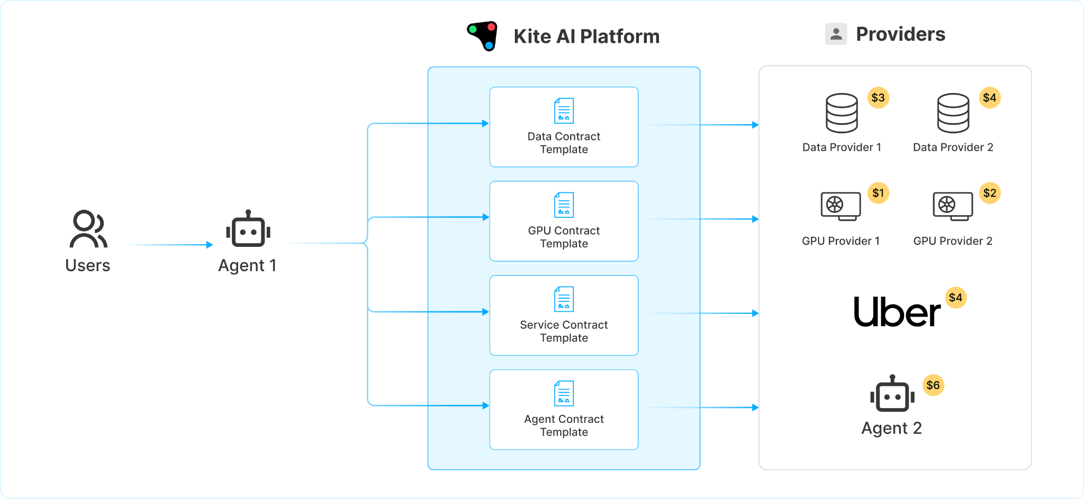
Kite AI Platform
Kite AI is the programmable trust layer in the Agentic AI world
Kite Agent Passport
Notes:
Kite Certificate “Digital Passport”
Verifiable AI identity: Ensures each agent can cryptographically prove not only who it is but also the legitimacy of its delegated authority from human principals.
Programmable Permissions: Embedded smart contracts and policies allow granular control over agent behaviors, delegation rights, authorized actions, and scoped permissions.
Digital Wallet Integration: Agents possess built-in digital wallets enabling machine-native payments that are instant, autonomous, and micro-payments globally. Transactions become frictionless, secure, and auditable by design

Slide 8
Kite AI Platform
Agent Builders
Transactions through Kite
$$$ Stablecoin Payments $$$
$$$ Stablecoin Payments $$$
Kite SDK
A
I
Service Providers
Agent Users
A
I
$$$
Authorize & Govern
Payments
Kite Passport
Kite Catalog
$$$ Stablecoin Payments $$$
Notes:
Kite Certificate “Digital Passport”
Verifiable AI identity: Ensures each agent can cryptographically prove not only who it is but also the legitimacy of its delegated authority from human principals.
Programmable Permissions: Embedded smart contracts and policies allow granular control over agent behaviors, delegation rights, authorized actions, and scoped permissions.
Digital Wallet Integration: Agents possess built-in digital wallets enabling machine-native payments that are instant, autonomous, and micro-payments globally. Transactions become frictionless, secure, and auditable by design

Slide 9
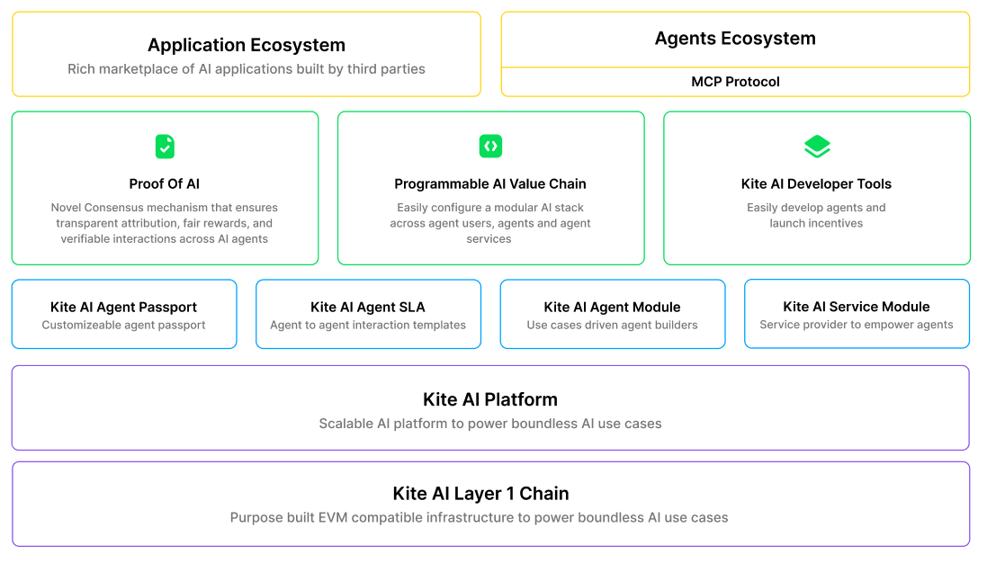
Architecture
Kite AI platform architecture

Slide 10


Demo Use Case
Scenario 1: Personal Agent for groceries
$$$
preferences
A
I
Costco
Please help me to refill my groceries
$$$
A
I
A
I
Wholefood
One- time Pre-authorize & Governance
Shopping Agent
Customer
(Human)
Best Price
$$$
A
I
Safeway
<$10 auto approve $1000 monthly limit
Notes:
Kite Certificate “Digital Passport”
Verifiable AI identity: Ensures each agent can cryptographically prove not only who it is but also the legitimacy of its delegated authority from human principals.
Programmable Permissions: Embedded smart contracts and policies allow granular control over agent behaviors, delegation rights, authorized actions, and scoped permissions.
Digital Wallet Integration: Agents possess built-in digital wallets enabling machine-native payments that are instant, autonomous, and micro-payments globally. Transactions become frictionless, secure, and auditable by design

Slide 11
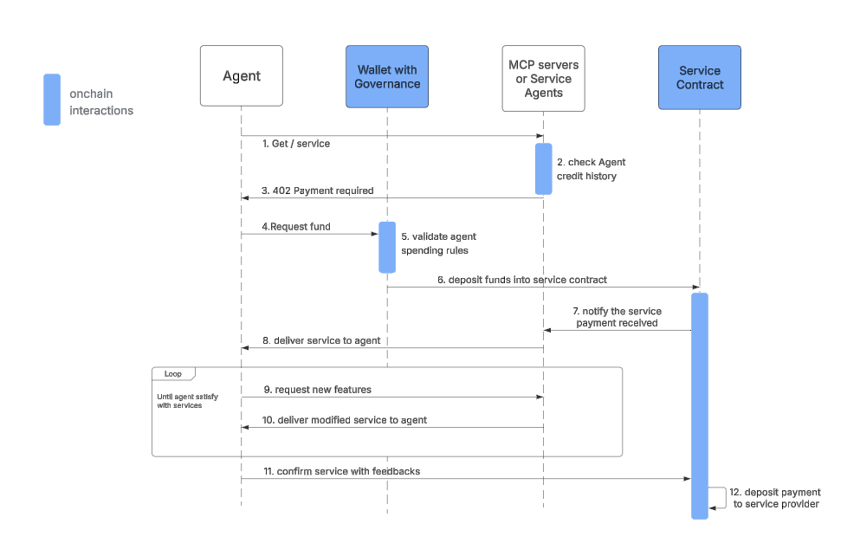
User Persona
Flow Diagram
Agent User Usage Flow
Notes:
Kite AI provides contract-based coordination layer -> lets agents and applications to interact with AI assets (data, GPU, models) under clearly stated usage policy, budget and contribution rules
Each model, data set, embedded with persistent identity metadata - checks how it is used, enforce logic, pricing - makes sure every contributor is paid fairly
—--------
OPTION 1: replace Uber with AWS logo. have a SLA with my data & GPU providers that I am consuming from.
OPTION 2: Change the story and keep the logos. -> Birthday planning story.
Image you are planning a party -> book a restaurant on Saturday, book a Uber trip, buy a gift based on the knowledge on you. Today these are three separate tasks. In the future, it will be all done by one agent.
What that agent needs to do:
1. put down a credit card/money deposit for the restaurant.
2. purchase the gift for you with real money.
3. implied SLA in case the original restaurant is not available -> need to find me the backup option.
4. book a Uber for me 1 hour before the reservation time.

Slide 12




Kite AI Platform
Scenario 2: Personal Agent for ordering service
preferences
Order me an uber to ferry building
A
I
Customer
(Human)
One- time Pre-authorize & Governance
Ordering
<$10 auto approve $1000 monthly limit
Notes:
Kite Certificate “Digital Passport”
Verifiable AI identity: Ensures each agent can cryptographically prove not only who it is but also the legitimacy of its delegated authority from human principals.
Programmable Permissions: Embedded smart contracts and policies allow granular control over agent behaviors, delegation rights, authorized actions, and scoped permissions.
Digital Wallet Integration: Agents possess built-in digital wallets enabling machine-native payments that are instant, autonomous, and micro-payments globally. Transactions become frictionless, secure, and auditable by design

Slide 13
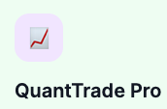
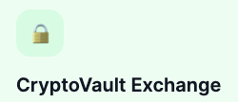
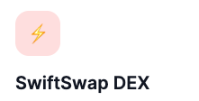
Kite AI Platform
Scenario 3: Trading AI Agent 24 * 7 portfolio management
preferences
Selected
Help me manage my portfolio
A
I
Selected
Customer
(Human)
Ongoing Authorize & Governance
<$10 auto approve $1000 monthly limit
Notes:
Kite Certificate “Digital Passport”
Verifiable AI identity: Ensures each agent can cryptographically prove not only who it is but also the legitimacy of its delegated authority from human principals.
Programmable Permissions: Embedded smart contracts and policies allow granular control over agent behaviors, delegation rights, authorized actions, and scoped permissions.
Digital Wallet Integration: Agents possess built-in digital wallets enabling machine-native payments that are instant, autonomous, and micro-payments globally. Transactions become frictionless, secure, and auditable by design

Slide 14
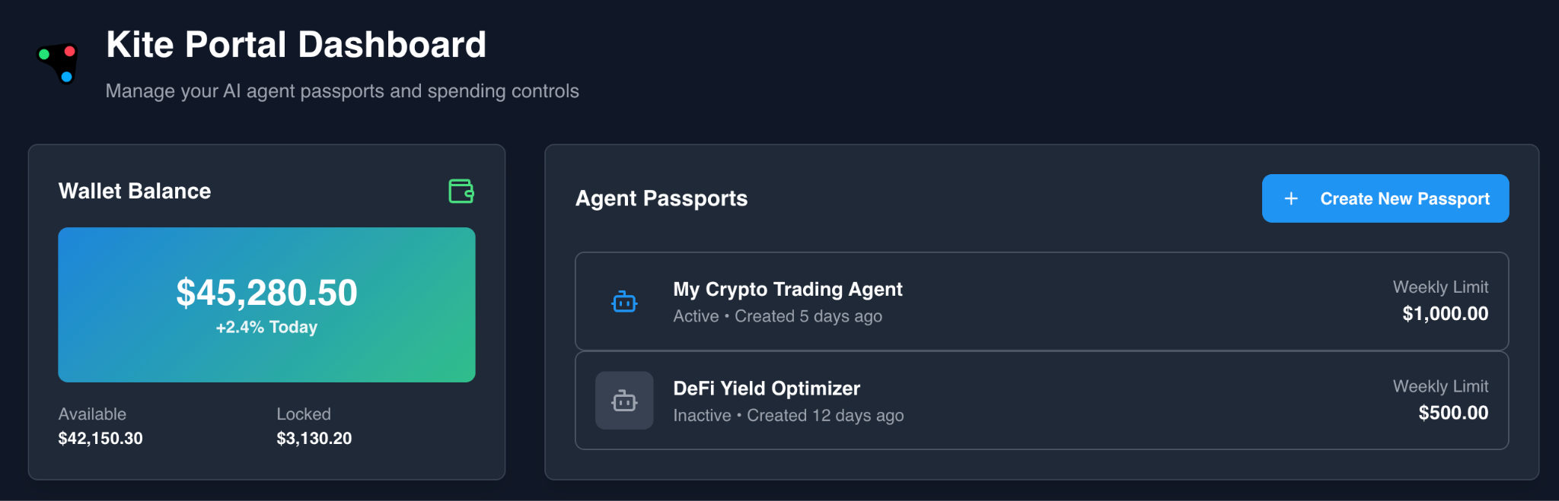
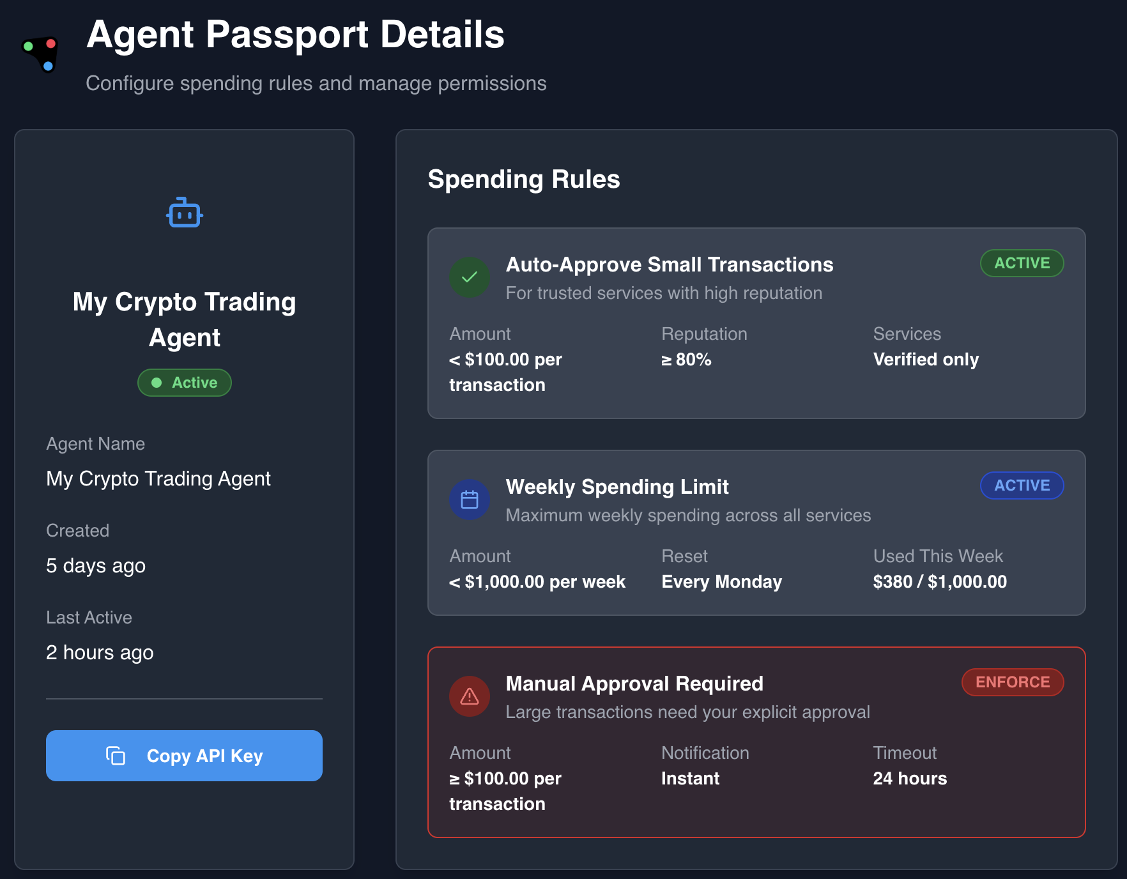
Kite AI Platform
How does Kite Passport Work

Slide 15

Kite AI Platform
Scenario 4: E-commerce thru Claude / ChatGPT / Cursor
$$$
preferences
A
I
My wife’s birthday is next Monday, help me with a Gift
$$$
Second Best Choice
A
I
Customer
(Human)
One- time Pre-authorize & Governance
Best Choice
$$$
<$10 auto approve $1000 monthly limit
A
I
Notes:
Kite Certificate “Digital Passport”
Verifiable AI identity: Ensures each agent can cryptographically prove not only who it is but also the legitimacy of its delegated authority from human principals.
Programmable Permissions: Embedded smart contracts and policies allow granular control over agent behaviors, delegation rights, authorized actions, and scoped permissions.
Digital Wallet Integration: Agents possess built-in digital wallets enabling machine-native payments that are instant, autonomous, and micro-payments globally. Transactions become frictionless, secure, and auditable by design

Slide 16
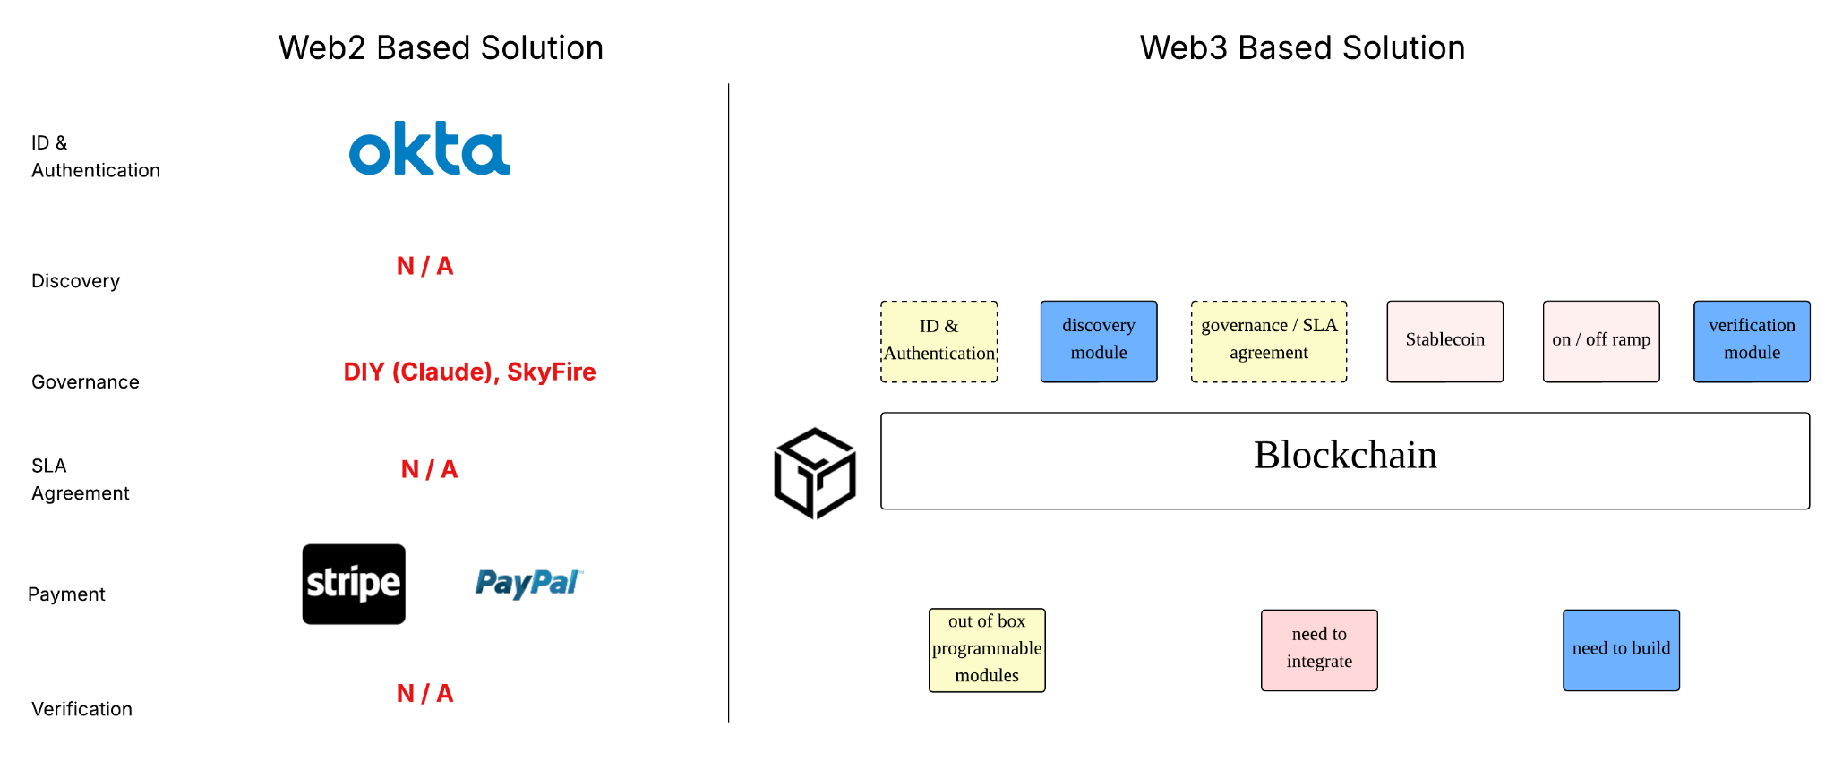
User Persona
Why blockchain based solution is better
Potential competitors may come from payment background or blockchain backgrounds. Competitors coming from blockchain background have edges over non blockchain solutions due to programmable(flexibility, smart), portability(public standards that any platform can integrate), interoperable(a2a interactions, any entity to operate on blockchain ), simplicity, cheaper(credit card 3% or 30 cents, blockchain minimum fee), cross borders and global payment system and verifiability.
Notes:
Kite AI provides contract-based coordination layer -> lets agents and applications to interact with AI assets (data, GPU, models) under clearly stated usage policy, budget and contribution rules
Each model, data set, embedded with persistent identity metadata - checks how it is used, enforce logic, pricing - makes sure every contributor is paid fairly
—--------
OPTION 1: replace Uber with AWS logo. have a SLA with my data & GPU providers that I am consuming from.
OPTION 2: Change the story and keep the logos. -> Birthday planning story.
Image you are planning a party -> book a restaurant on Saturday, book a Uber trip, buy a gift based on the knowledge on you. Today these are three separate tasks. In the future, it will be all done by one agent.
What that agent needs to do:
1. put down a credit card/money deposit for the restaurant.
2. purchase the gift for you with real money.
3. implied SLA in case the original restaurant is not available -> need to find me the backup option.
4. book a Uber for me 1 hour before the reservation time.

Slide 17
AI Native L1
Why is Blockchain the Right Solution here?
Think of the Kite Pass as an agent passport: it carries not just identity, but also verifiable delegation from a human principal, scoped permissions, spending limits, and authorized behaviors. Unlike traditional OAuth tokens, this is a chain of trust—cryptographically anchored and transparently auditable.
What makes blockchain uniquely suited for this:
Identity — cryptographically secure and universally verifiable
Programmable permissions — encoded as smart contracts/SLA
Digital wallets — enabling real-time, global micropayments
All composable and natively interoperable (most importantly, they can be delivered at the same time, such as using smart contract wallets)
On top of this, we can build an AI-native reputation network—not just ratings, but trust grounded in verifiable histories: contract execution records, delivery performance, refund behavior, uptime, etc. This moves us beyond today's easily gamed, AI-generated review systems.
That’s the trust fabric we’re building.

Slide 18
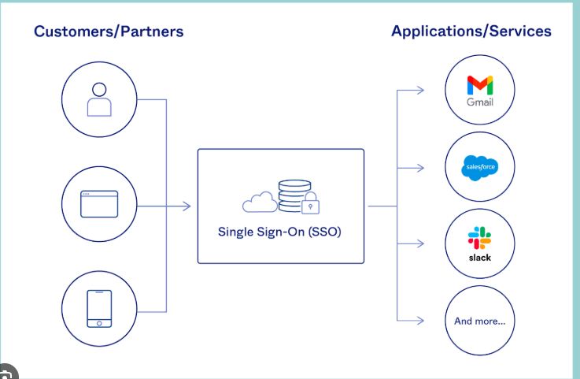
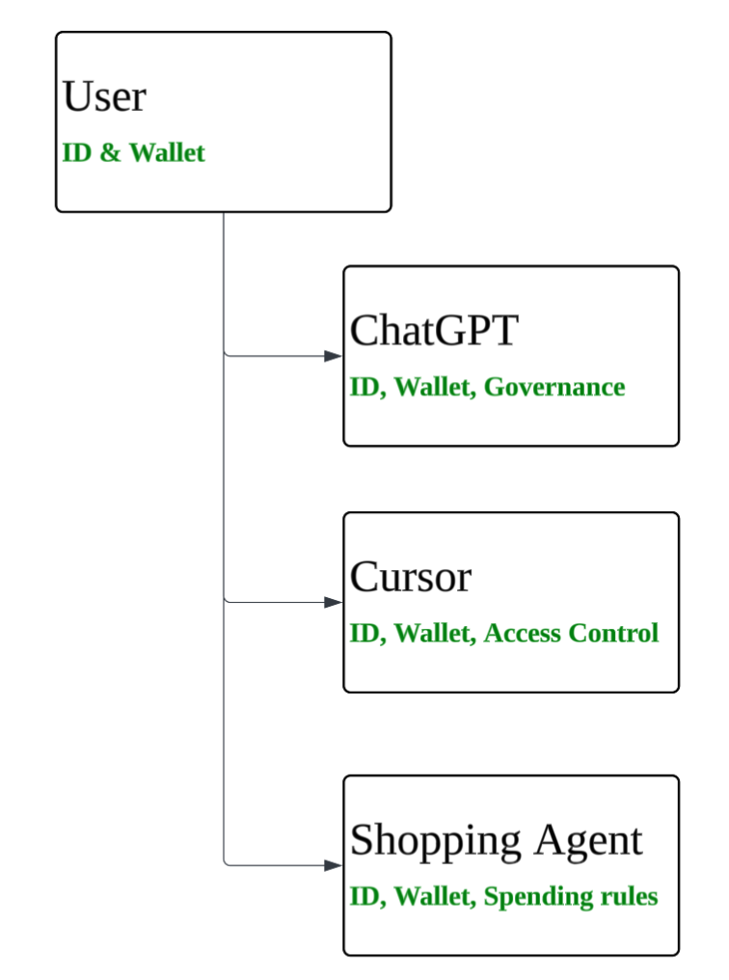
User Persona
ID & Authentication
Kite AI: Built for Agent ID / Wallet, simplified & programmable
Traditional Auth: not built agent and way too complex
Notes:
Kite AI provides contract-based coordination layer -> lets agents and applications to interact with AI assets (data, GPU, models) under clearly stated usage policy, budget and contribution rules
Each model, data set, embedded with persistent identity metadata - checks how it is used, enforce logic, pricing - makes sure every contributor is paid fairly
—--------
OPTION 1: replace Uber with AWS logo. have a SLA with my data & GPU providers that I am consuming from.
OPTION 2: Change the story and keep the logos. -> Birthday planning story.
Image you are planning a party -> book a restaurant on Saturday, book a Uber trip, buy a gift based on the knowledge on you. Today these are three separate tasks. In the future, it will be all done by one agent.
What that agent needs to do:
1. put down a credit card/money deposit for the restaurant.
2. purchase the gift for you with real money.
3. implied SLA in case the original restaurant is not available -> need to find me the backup option.
4. book a Uber for me 1 hour before the reservation time.

Slide 19
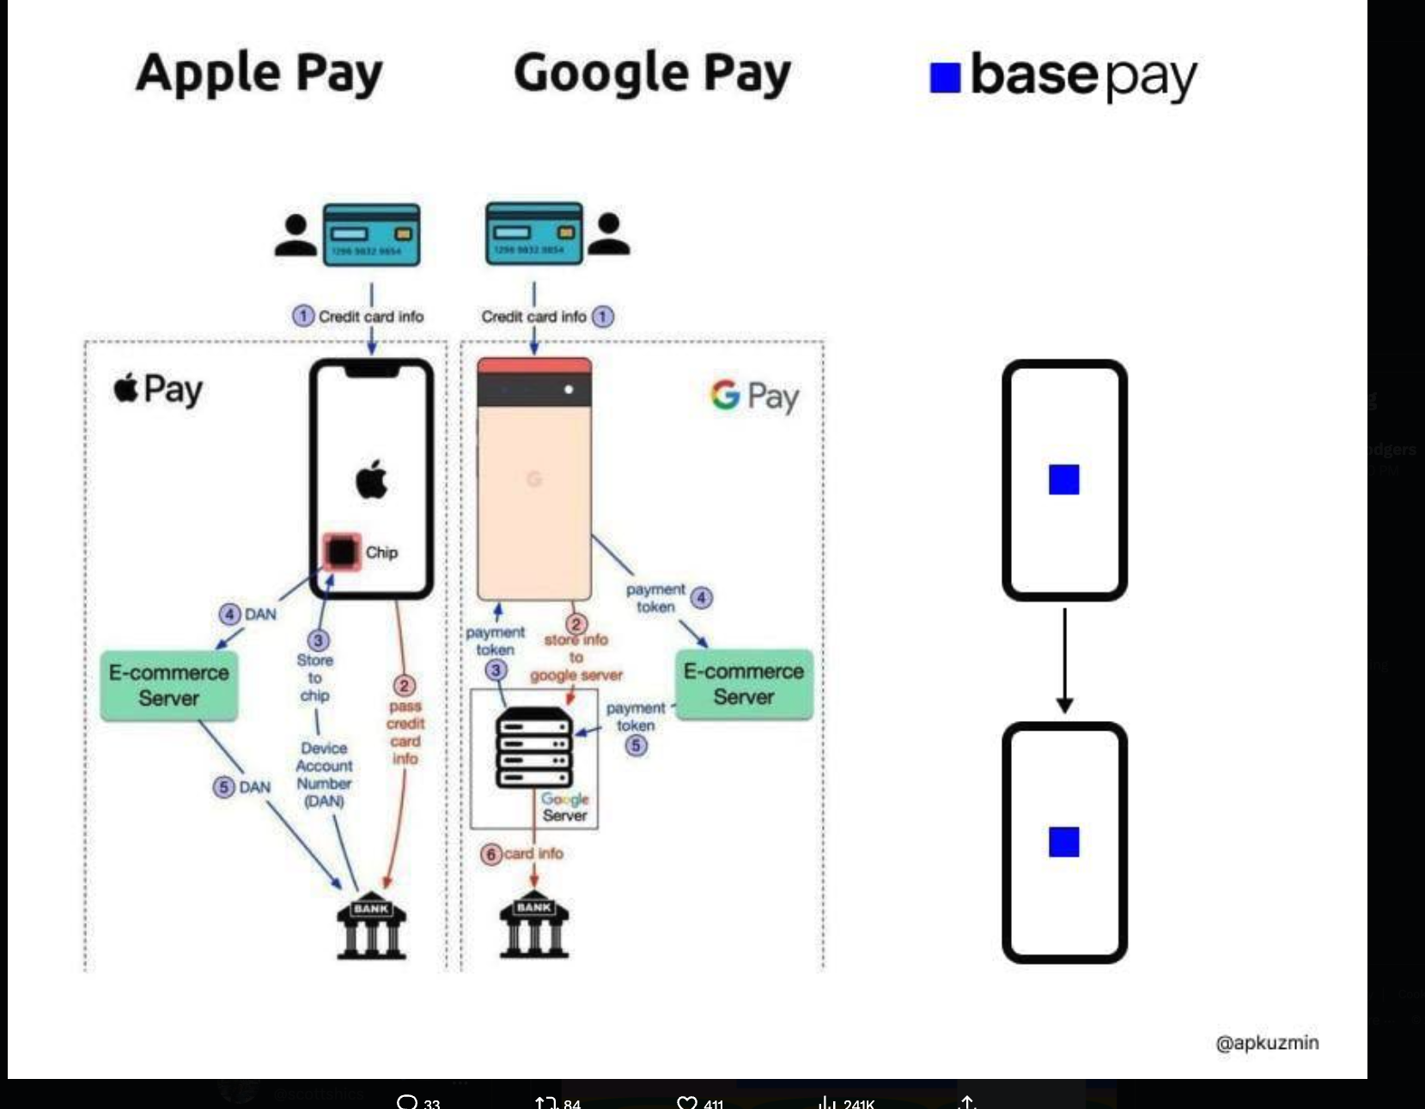
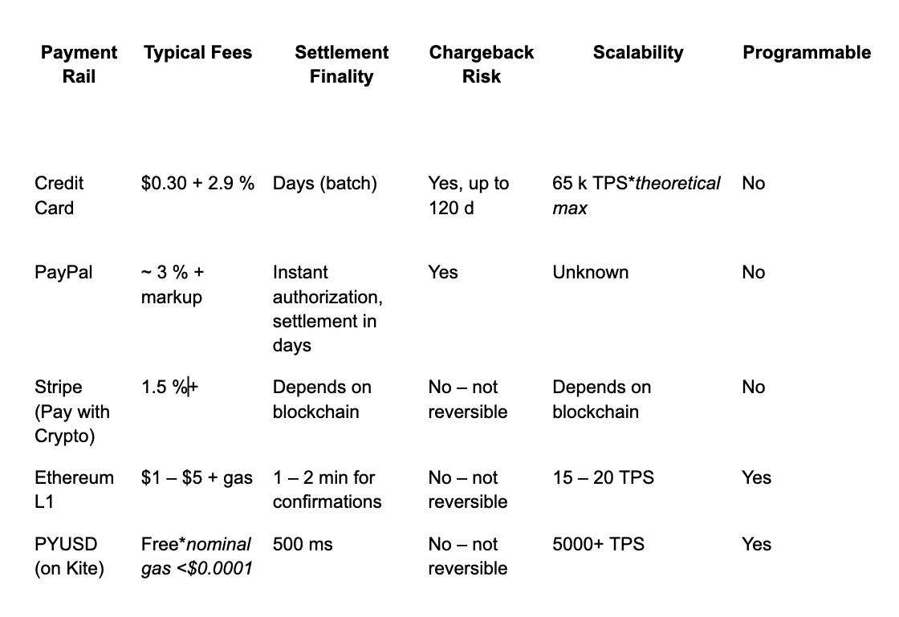
User Persona
Payment Rail Comparison
Simplified Architecture
Much better cost & features
Notes:
Kite AI provides contract-based coordination layer -> lets agents and applications to interact with AI assets (data, GPU, models) under clearly stated usage policy, budget and contribution rules
Each model, data set, embedded with persistent identity metadata - checks how it is used, enforce logic, pricing - makes sure every contributor is paid fairly
—--------
OPTION 1: replace Uber with AWS logo. have a SLA with my data & GPU providers that I am consuming from.
OPTION 2: Change the story and keep the logos. -> Birthday planning story.
Image you are planning a party -> book a restaurant on Saturday, book a Uber trip, buy a gift based on the knowledge on you. Today these are three separate tasks. In the future, it will be all done by one agent.
What that agent needs to do:
1. put down a credit card/money deposit for the restaurant.
2. purchase the gift for you with real money.
3. implied SLA in case the original restaurant is not available -> need to find me the backup option.
4. book a Uber for me 1 hour before the reservation time.

Slide 20
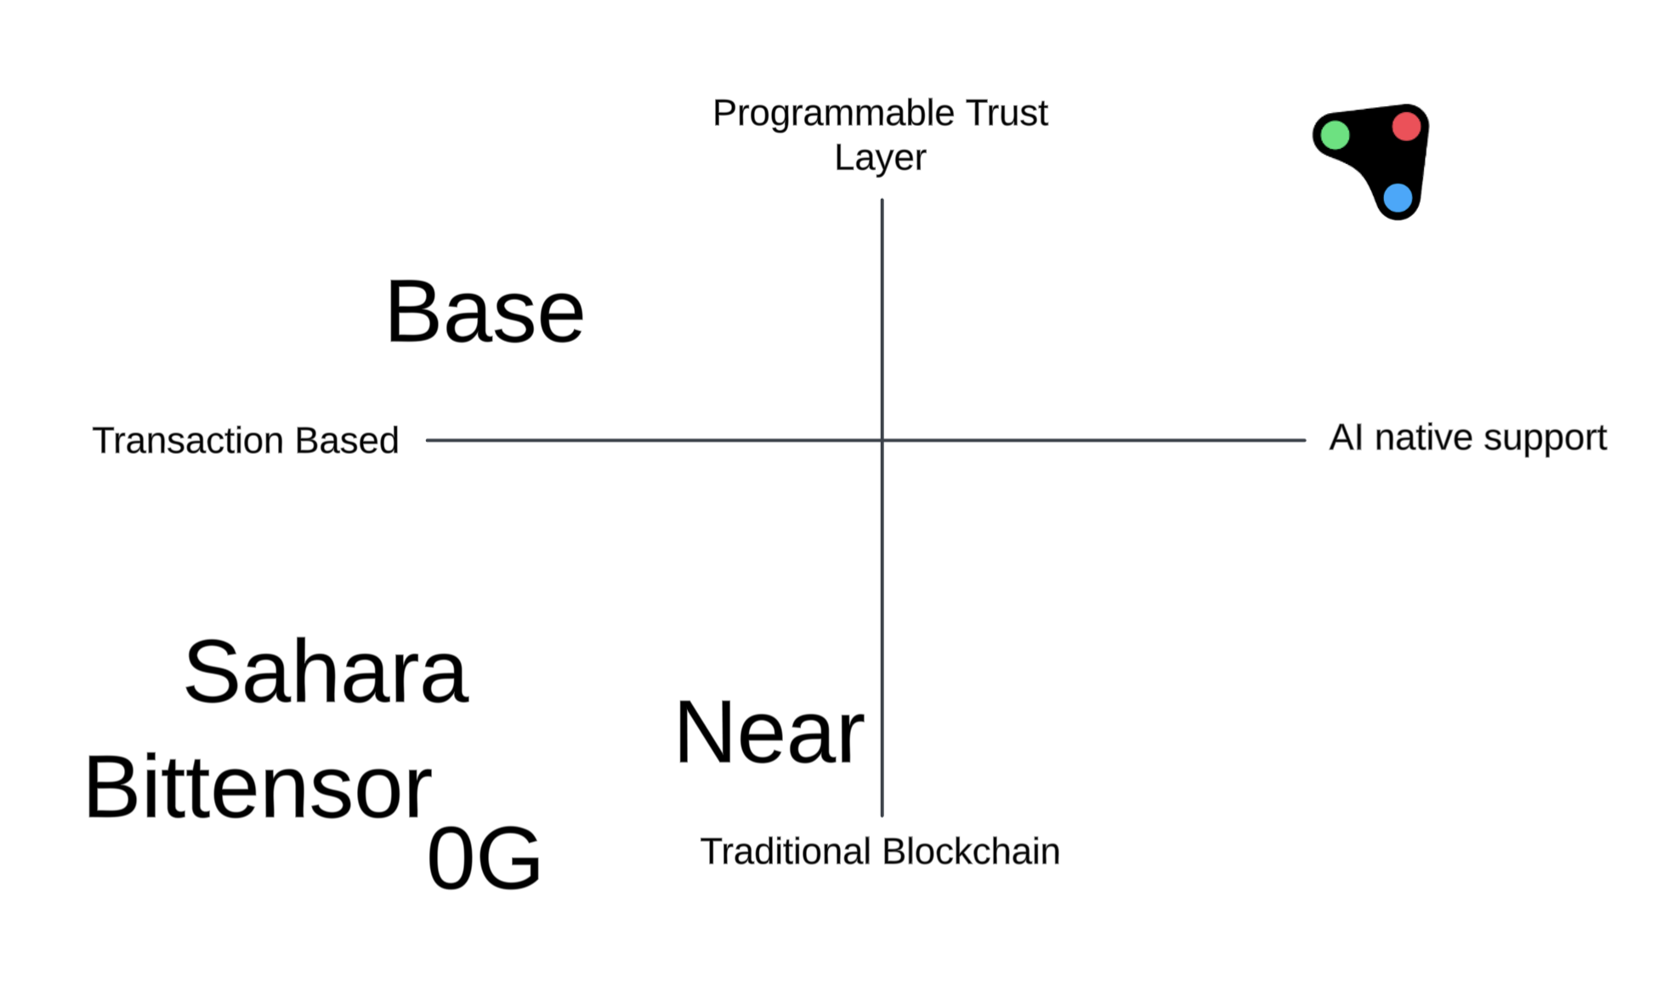
Why Kite AI is better than other blockchain based solution

Slide 21
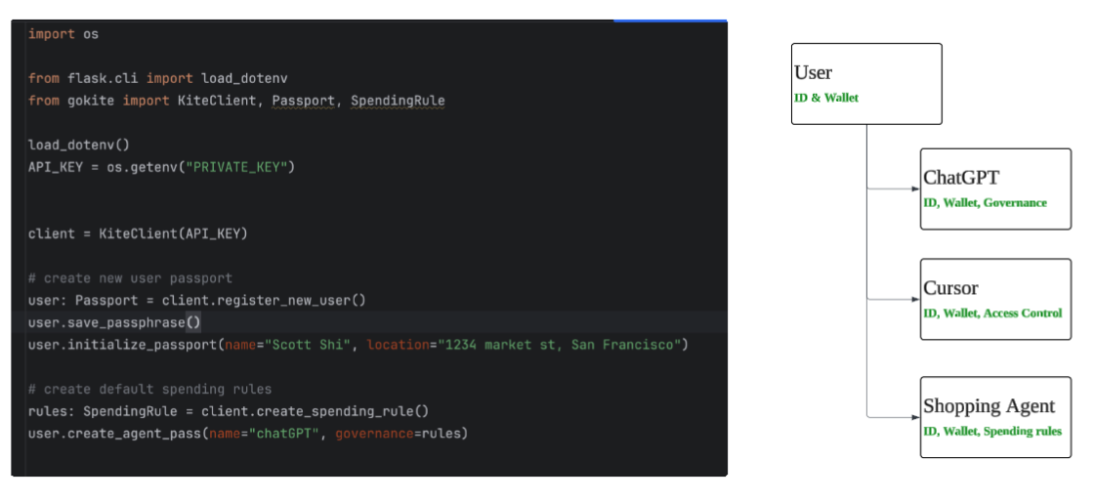
User Persona
Programmable Trust Layer: Kite Passport
Notes:
Kite AI provides contract-based coordination layer -> lets agents and applications to interact with AI assets (data, GPU, models) under clearly stated usage policy, budget and contribution rules
Each model, data set, embedded with persistent identity metadata - checks how it is used, enforce logic, pricing - makes sure every contributor is paid fairly
—--------
OPTION 1: replace Uber with AWS logo. have a SLA with my data & GPU providers that I am consuming from.
OPTION 2: Change the story and keep the logos. -> Birthday planning story.
Image you are planning a party -> book a restaurant on Saturday, book a Uber trip, buy a gift based on the knowledge on you. Today these are three separate tasks. In the future, it will be all done by one agent.
What that agent needs to do:
1. put down a credit card/money deposit for the restaurant.
2. purchase the gift for you with real money.
3. implied SLA in case the original restaurant is not available -> need to find me the backup option.
4. book a Uber for me 1 hour before the reservation time.

Slide 22
User Persona
Programmable Trust Layer: DIY without Kite AI
Agent Developer built on top of Base / Solana / Ethereum etc
Step 1: create user wallet
Self custodial, manage user private key, social login integrations ….
Step 2: Create agent wallet
Private key management for agent wallet
Step 3: Link agent wallet to user wallet and setup delegation
Step 4: Write smart contract spending rules, provide different template for different users
Step 5: Integrate with stablecoin, on / off ramp and credit card etc.
Step 6: build analytics / monitoring / alerting for agents / users
…
Notes:
Kite AI provides contract-based coordination layer -> lets agents and applications to interact with AI assets (data, GPU, models) under clearly stated usage policy, budget and contribution rules
Each model, data set, embedded with persistent identity metadata - checks how it is used, enforce logic, pricing - makes sure every contributor is paid fairly
—--------
OPTION 1: replace Uber with AWS logo. have a SLA with my data & GPU providers that I am consuming from.
OPTION 2: Change the story and keep the logos. -> Birthday planning story.
Image you are planning a party -> book a restaurant on Saturday, book a Uber trip, buy a gift based on the knowledge on you. Today these are three separate tasks. In the future, it will be all done by one agent.
What that agent needs to do:
1. put down a credit card/money deposit for the restaurant.
2. purchase the gift for you with real money.
3. implied SLA in case the original restaurant is not available -> need to find me the backup option.
4. book a Uber for me 1 hour before the reservation time.

Slide 23
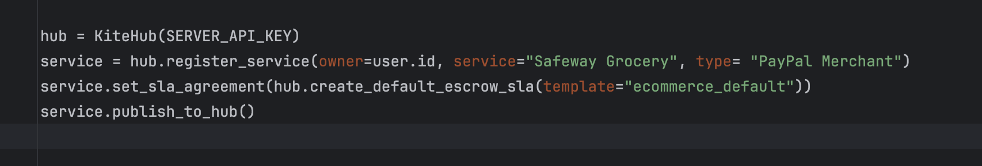
User Persona
Programmable Trust Layer: Kite SLA Agreement
Kite Agent Passport
Notes:
Kite AI provides contract-based coordination layer -> lets agents and applications to interact with AI assets (data, GPU, models) under clearly stated usage policy, budget and contribution rules
Each model, data set, embedded with persistent identity metadata - checks how it is used, enforce logic, pricing - makes sure every contributor is paid fairly
—--------
OPTION 1: replace Uber with AWS logo. have a SLA with my data & GPU providers that I am consuming from.
OPTION 2: Change the story and keep the logos. -> Birthday planning story.
Image you are planning a party -> book a restaurant on Saturday, book a Uber trip, buy a gift based on the knowledge on you. Today these are three separate tasks. In the future, it will be all done by one agent.
What that agent needs to do:
1. put down a credit card/money deposit for the restaurant.
2. purchase the gift for you with real money.
3. implied SLA in case the original restaurant is not available -> need to find me the backup option.
4. book a Uber for me 1 hour before the reservation time.

Slide 24
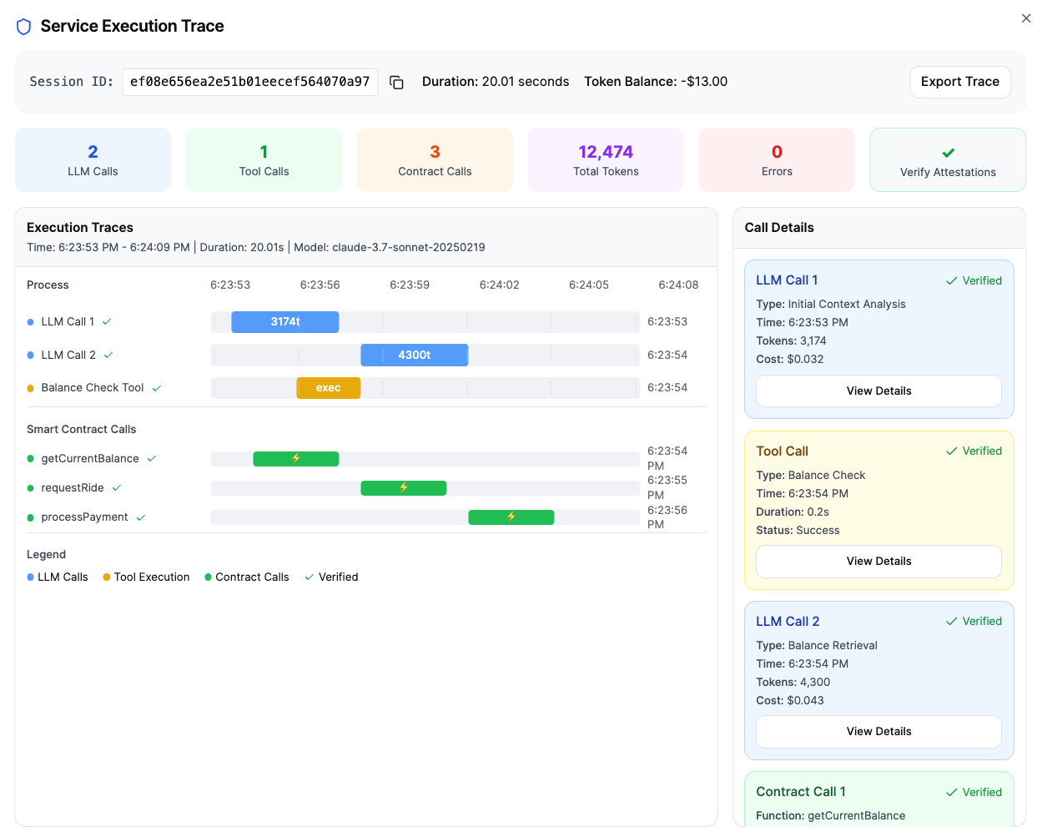
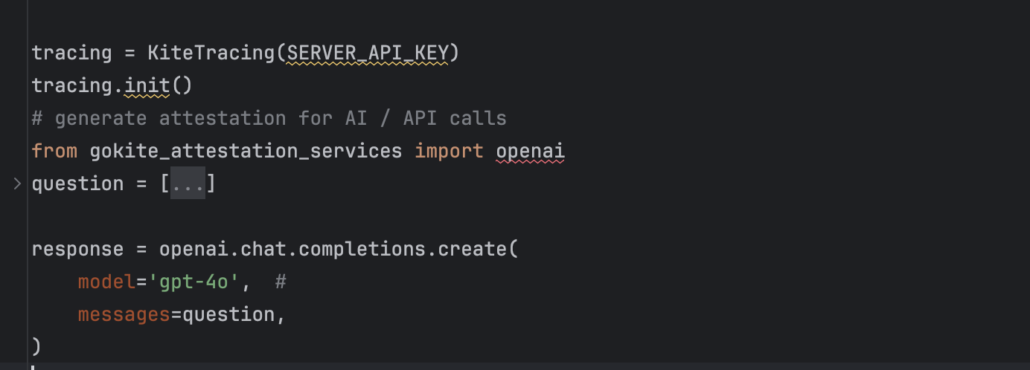
Programmable Trust Layer: Agent interaction verification

Slide 25
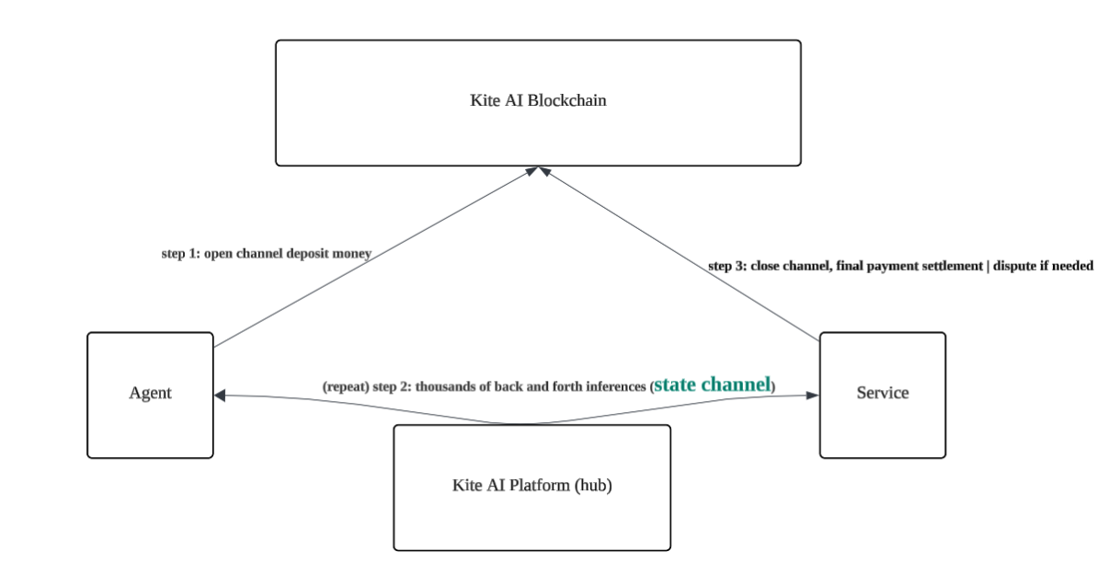
AI native support: AI Inference micro payment
Txn patterns: 2-30 seconds latency, $0.003 - $80 txn fee, broadcast to all nodes to reach consensus Inference patterns: 100ms latency, $0.000001 fee or less, nearest node to accept the inference

Slide 26
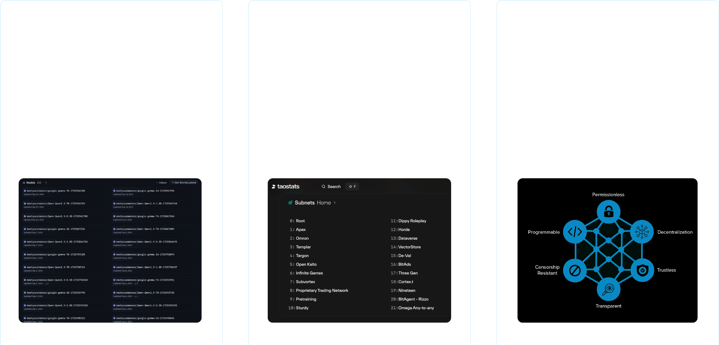
Value Proposition
Kite unlocks monetization, composability, and liquidity for AI assets
Monetizable Open AI Marketplace
Better AI Module Ecosystem
Vibrant DeFi Economy
Kite AI provides monetization for data owners, model builders, and service providers who currently are not properly monetized, let alone selling access to AI agents in the existing internet system.
Open Ecosystem Marketplace where modules can find real demand and supply powered by Kite AI’s battle tested infrastructure and Proof of AI consensus mechanism
Kite AI provides the ecosystem with a way to invest in tokenized AI assets through familiar DeFi protocols

Slide 27



















Team
The Best Team for AI and Data
Founders
Chi Zhang
Cofounder, CEO
Scott Shi
Cofounder, CTO
Product manager @ Databricks (leading key data engineering products)
Founder of Uber Safety Data, Eng Committee Chair @ Uber (also built Uber’s “Scale AI”)
Founding member, ML & product @ dotData (one of the top AutoML platforms)
Founding engineer, Tech Lead & @ Salesforce Einstein AI (patented dataflow orchestrators)
AI Researcher @ Gilead Science (Cancer diagnosis)
Cofounder & CTO @ RisingWave (Streaming database, $40M+ raised)
Ph.D. in ML @ UC Berkeley (focus on explainable AI with causality)
Engineer @ Electronic Arts; M.S. in CS @ UIUC
Executive Team
Lei Lei
Yusuke Muraoka
Vikas Pandey
VP, Head of BD & Strategy
Principal Al Engineer
Head of Protocol
Head of BD @ Near Foundation
Co-Founder, Principal AI Scientist @ dotData (AutoML)
Head of Eco Infra @ Near Foundation
Head of Institutional Sales @ BlockFi
Senior Researcher @ NEC (publications at top AI conferences NeurIPS & ICML)
3 time blockchain Co-Founder & CTO
(Built on Ethereum, Cosmos and NEAR)
Head of Earn @ AscendEX (CEX)
Technical Ambassador @ Linux Foundation
10+ yrs on Wall Street (Deutsche Bank)
30+ AI patents on NLP & feature eng
MBA @ Harvard; B.S. in Econ @ MIT
M.S. in CS @ University of Tokyo
Senior Engineer @ ING, Infosys

Slide 28










Team
World-class Al and Blockchain angels & advisors
Evan Cheng
Dawn Song
Co-founder & CEO @ Mysten Labs
CS Professor @ UC Berkeley
Director of Engineering @ Meta
Cofounder @ Oasis Labs, Co-director @ Berkeley RDI
Haiyan Huang
Sriram Vishwanath
Statistics Professor @ UC Berkeley
Computer Engineering Professor @ UT Austin
Chair, Department of Statistics @ UC Berkeley
Cofounder @ Quai Network, Texas Blockchain Accelerator
Yuke Zhu
Grigore Roșu
CS Professor @ UT Austin
CS Professor @ UIUC
Co-lead with Jim Fan, GEAR Lab @ NVIDIA Research
Cofounder @ Pi Squared , Runtime Verification
Toby Stuart
Shao Zheng
Business Professor @ UC Berkeley-Haas
Head of Data Infra @OpenAI
Cofounder, board director @ Flock Freight
Distinguished Engineer @Uber
John Liu
Adelyn Zhou
Head of Product, Web3 & Blockchain @ Amazon AWS
CMO, Chief Ecosystem Growth @ Chainlink
Head of Enterprise Product @ Visible Alpha
Marketing lead @ Amazon, BCG

Slide 29
KITE AI
Appendix

Slide 30
Example
Payment challenge: dynamic attributions
$0.1 / call
Expert of medical research
Compare recent studies on the effects of intermittent fasting on diabetes and upload the summary to Google Docs.
$1 / records
A
I
Research assistant
Ask
Search
Ask
Research Papers
A
I
Inference
Paper Evaluation
$2 / Mtokens
$0.1 / sample
Use
Challenges:
1. Approval from user each time?
2. Different payment providers?
3. Service agreement vs payment
$0.1 / call
Upload to Google doc
Notes:
-Summarize medical research
-provider and micropayments
-agent don’t know cost upfront
-can’t attribute value back to contributors or pay them in real-time

Slide 31
Solution
Need Identity and Verification
$
$$
Ask a task
Use the service
A
I
Task complete
Service complete
✅
✅
❌
-$$$
+$
-$$
+$$
$
$
$
Agent should be responsible for payment
Notes:
-Summarize medical research
-provider and micropayments
-agent don’t know cost upfront
-can’t attribute value back to contributors or pay them in real-time

Slide 32
Solution
Autonomous payments with authorization
$0.1 / call
Budget $19.9
$1 / record
Ask
Search
A
I
Pay
Ask
Authorize
A
I
Inference
Pay
Budget $20
Authorize
$2 / Mtokens
$0.1 / sample
Use
Pay
$0.1 / call
Notes:
• Kite AI Layer 1 Chain: An EVM-compatible foundation purpose-built for AI applications, providing high throughput and scalability.
• Proof of AI: A novel consensus mechanism ensuring transparent attribution, fair rewards, and coordination across specialized subnets.
• Programmable AI Value Chain: A modular approach to configure collaboration between data, models, and agents.
• Kite AI Developer Tools: Comprehensive toolkits that simplify agent development and reward distribution.
• Kite AI Data Subnets: High-quality data pools designed for advanced AI research and development.
• Kite AI Model Subnets: Robust repositories for building and optimizing AI models.
• Kite AI Agent Subnets: Ecosystems for creating and running intelligent, autonomous agents.
• Application Ecosystem: A rich marketplace where third-party developers launch and scale AI-powered applications.

Slide 33
Mission
Agents
Demand
A
I
A
I
A
I
Identity, Attribution, Verification, Payments
GPU
A
I
Supply
GPU
Tools
Agents
Data
Models
GPUs
Notes:
• Kite AI Layer 1 Chain: An EVM-compatible foundation purpose-built for AI applications, providing high throughput and scalability.
• Proof of AI: A novel consensus mechanism ensuring transparent attribution, fair rewards, and coordination across specialized subnets.
• Programmable AI Value Chain: A modular approach to configure collaboration between data, models, and agents.
• Kite AI Developer Tools: Comprehensive toolkits that simplify agent development and reward distribution.
• Kite AI Data Subnets: High-quality data pools designed for advanced AI research and development.
• Kite AI Model Subnets: Robust repositories for building and optimizing AI models.
• Kite AI Agent Subnets: Ecosystems for creating and running intelligent, autonomous agents.
• Application Ecosystem: A rich marketplace where third-party developers launch and scale AI-powered applications.

Slide 34
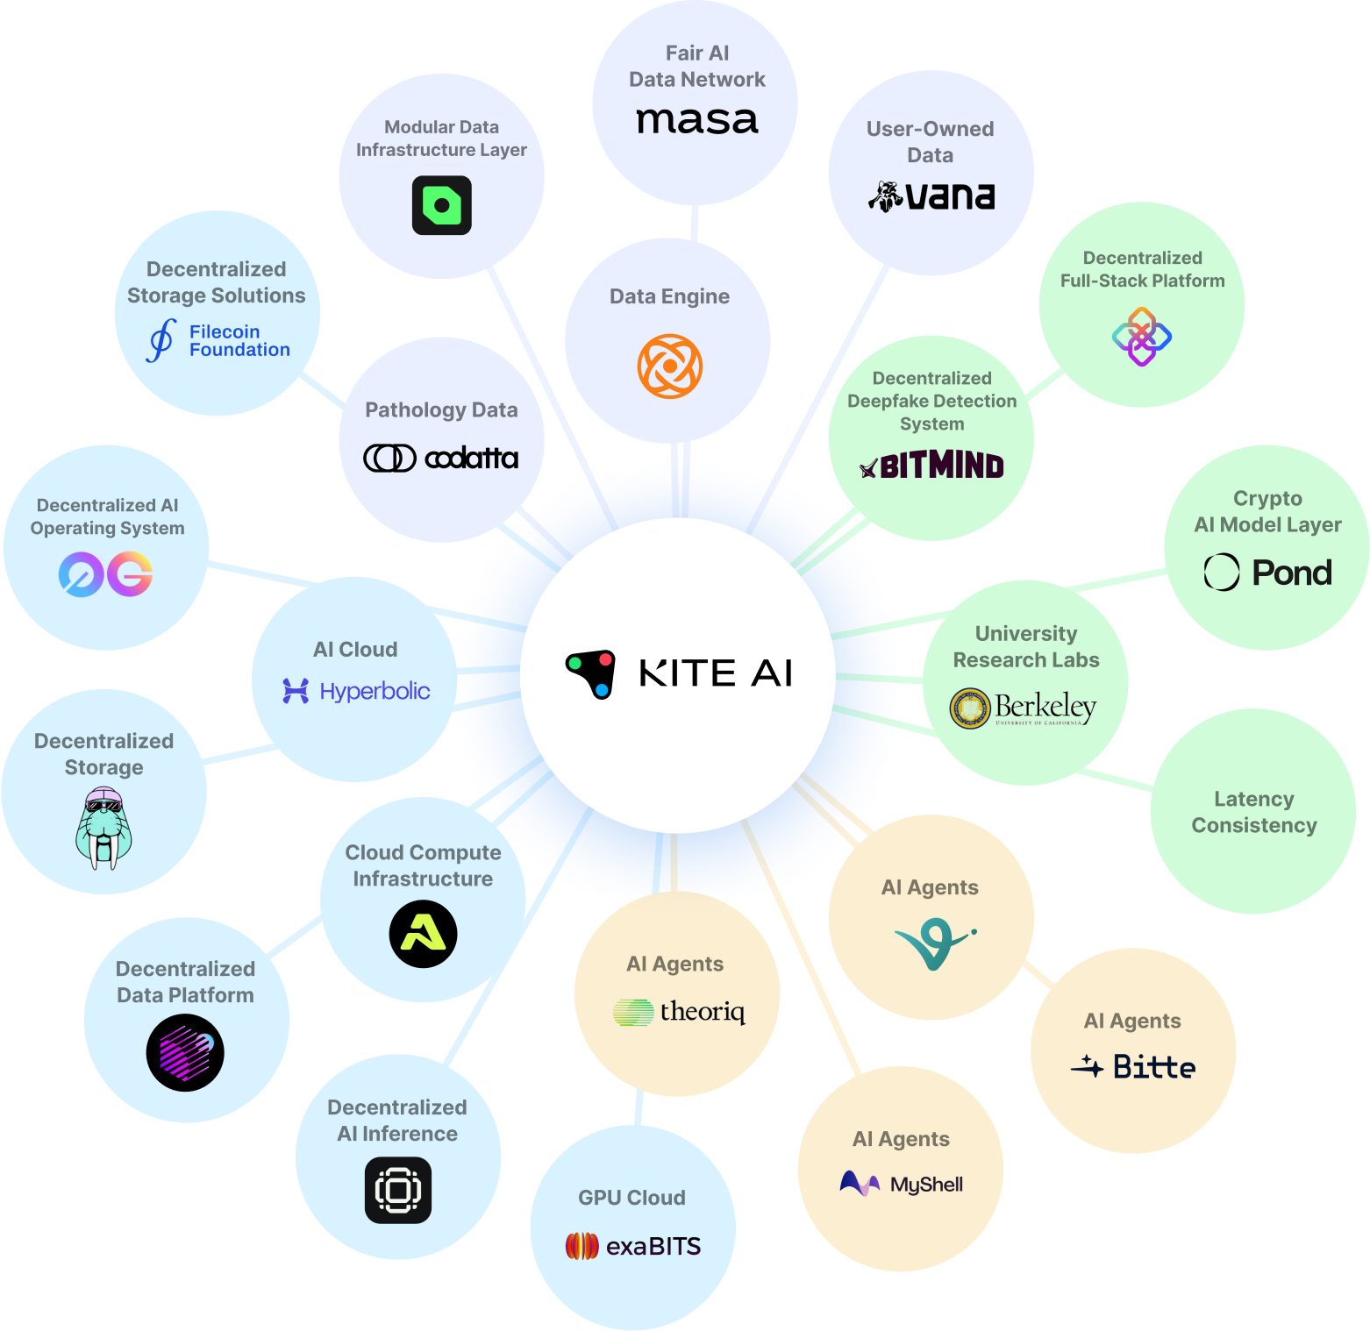
GTM
Flywheel of demand & supply
Data Subnets
Key participants:
Model Subnets
AI Agent Builders:
Access and compose data, models, and APIs on-demand—while contributing value back
Model Subnets:
Access to high-quality data and base models for building custom SOTA models, & fair compensation on those models
Data Subnets:
Fair monetization on their high-quality essential data to increase revenue
Service Subnets:
Service Subnets
Sell access to their services to AI agents for new revenue streams
AI Agent Builders

Slide 35
Kite AI Platform
How Kite powers verified identity, attribution & payment
Agent Network = Dynamic and Autonomous
How can they pay securely?
A
I
A
I
agent
service
Spending
rules
SLA and dispute
$$$
A
I
Agent Users
Service Providers
Smart contract
Smart contract
Our solution = Programmable Smart Contracts from both Agent and Service sides
Flexible, yet autonomous enforcement of control and payment rules

